Slide 1
Introduction to Chatbot Anatomy
Welcome to Lesson 1: Chatbot Anatomy
In this lesson, we'll explore the key components that make up a chatbot using LLMs.
We'll be using FastAPI for the server, ReactJS for the client, and LangChain to manage conversation flow.

Slide 2
What is a Chatbot?
A chatbot is a software application used to conduct conversations.
It mimics human conversational abilities using Natural Language Processing (NLP).
Modern chatbots leverage LLMs like GPT-4 and frameworks such as LangChain to generate responses.
Our chatbot will integrate with OpenAI's API to generate natural language responses.

Slide 3
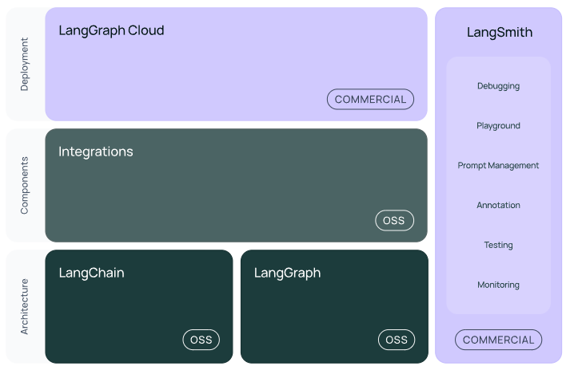





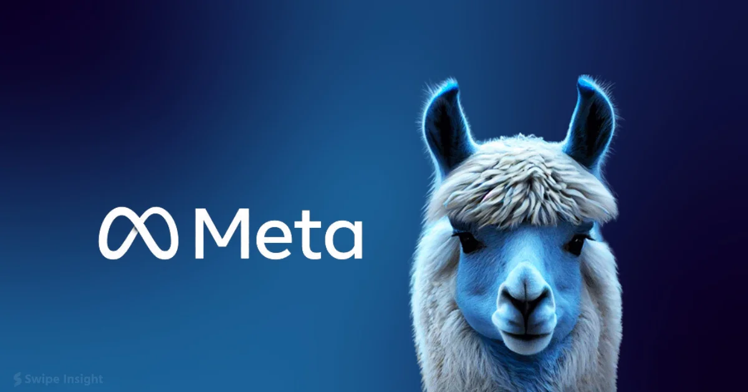
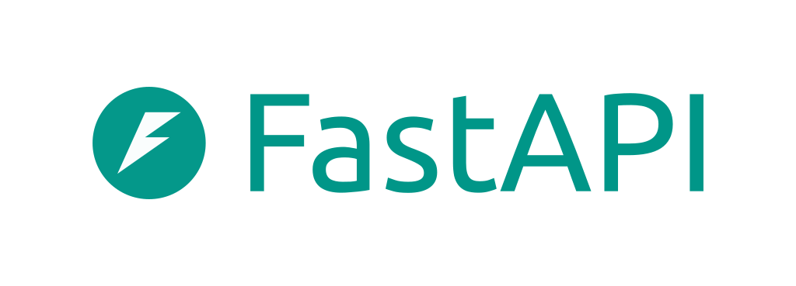
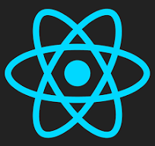

Key Components of Our Chatbot
LLM
HumanMessage
[role: “user”]
AIMessage
[role: “assistant”]
Prompt Templates
Prompt Value
Output Parser
SystemMessage
[role: “system”]
ToolMessage
[role: “tool”]

Slide 4
Natural Language Understanding (NLU)
NLU is the part of the chatbot that helps it understand user input.
It breaks down user queries into smaller, more manageable tokens.
OpenAI's LLM handles tokenization and context understanding.
LangChain helps in structuring prompts to ensure context continuity.

Slide 5
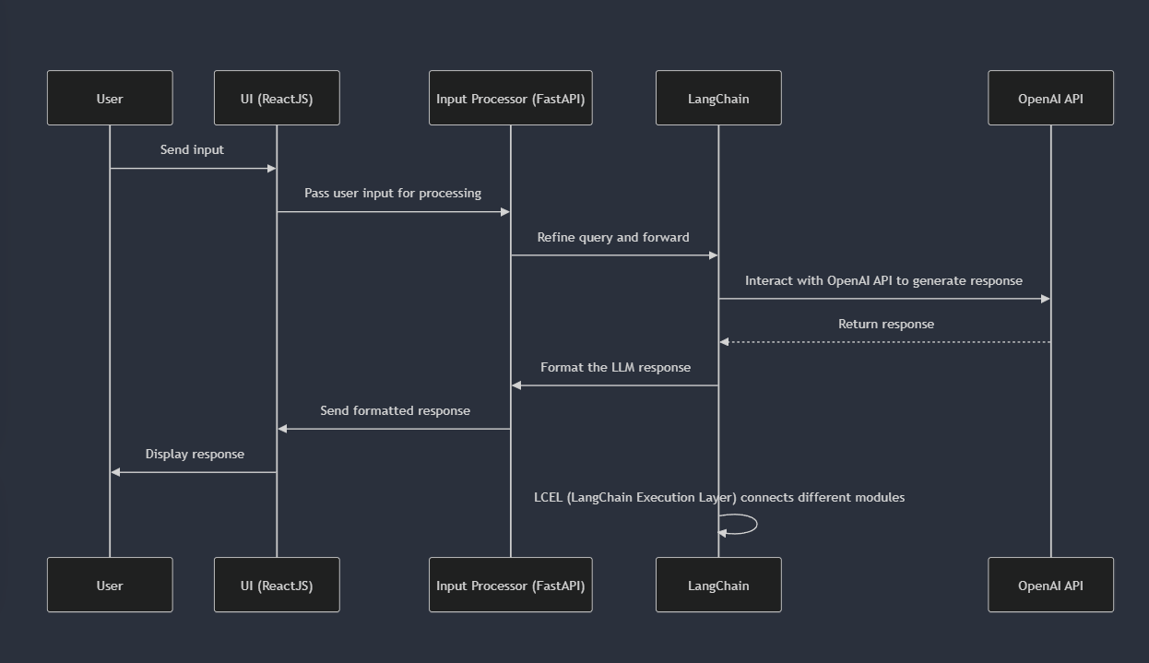
Chatbot Flow

Slide 6
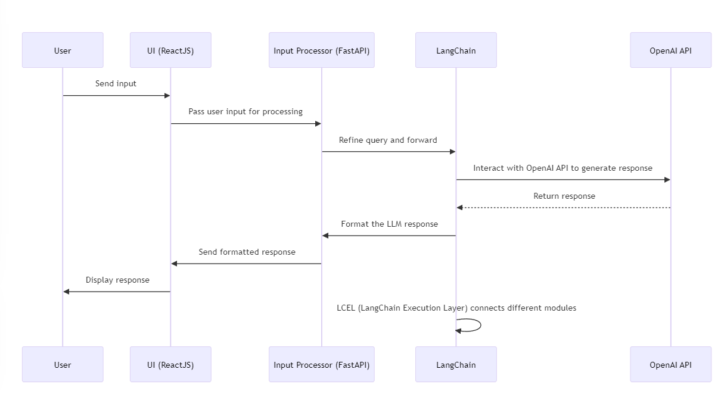
Chatbot Flow

Slide 7
API Integration
The chatbot interacts with LLMs via APIs like OpenAI API.
FastAPI routes incoming requests from the ReactJS client asynchronously and passes them to LangChain.
Environment variables (.env) are used to securely manage API keys for OpenAI, loaded via python-dotenv.

Slide 8
Coding Exercise
> git clone https://github.com/marty916/Enterprise-LLM-RAG.git
> cd Enterprise-LLM-RAG/lessons/01-chatbot

